Slide 1
Lex Automagica:
Blockchains & the Law
Blockchain & Legal innovation I - Lecture 2

Slide 2
What Laws Apply to a Peer-to-Peer Network?

Slide 3
What is a Blockchain
“At their core, blockchains are decentralised databases maintained by distributed network of computers. They blend together a variety of different technologies, including peer-to-peer network, public private key cryptography, and consensus mechanisms – to create a novel type of database.”

Slide 4
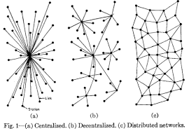
Decentralised and Distributed?
Decentralised?
What We Really Mean
Decentralised = no single controller
Distributed = No single location

Slide 5
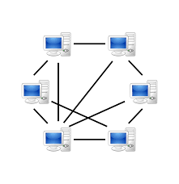
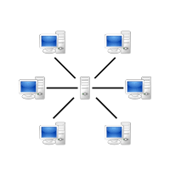
Peer-to-Peer Network

Slide 6
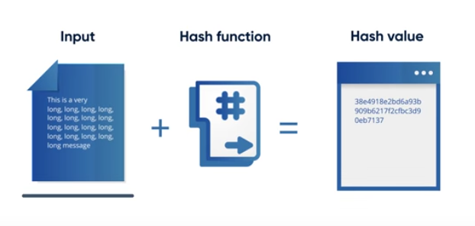
Hash Functions
Convert an input of any length into a fixed size string of text using a mathematical function.
Useful video here: https://www.youtube.com/watch?v=2BldESGZKB8

Slide 7
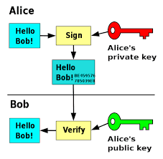
Public-Private Key Cryptography

Slide 8
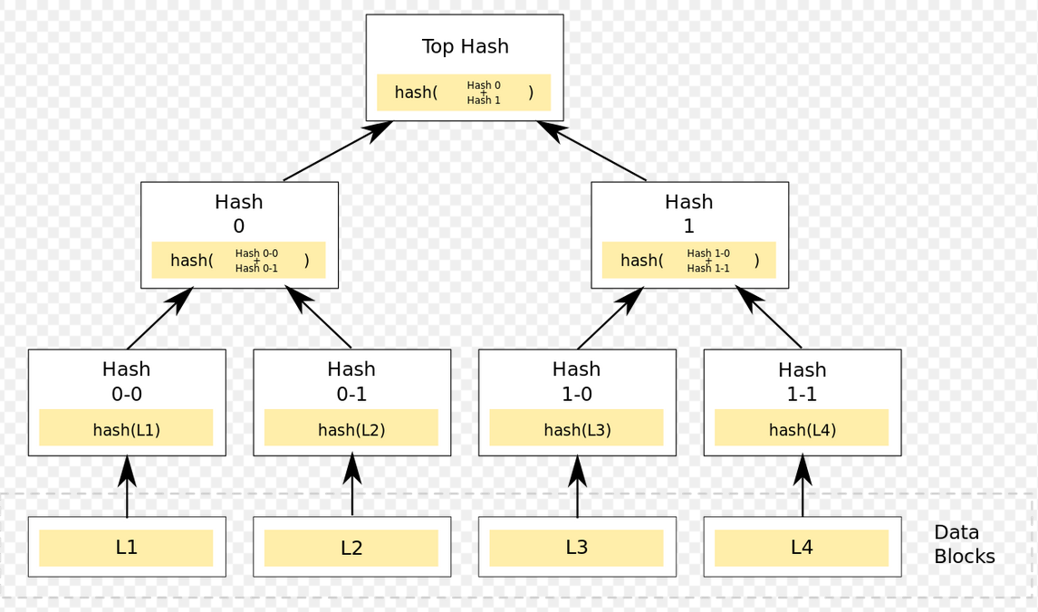
Merkel Trees

Slide 9
Characteristics of Blockchains
Disintermediation Tool: no single controller
Tamper Resistant: hard to edit or attack
Transparent: authenticated non repudiable data
Pseudonymity: can sign txns without revealing true identity
Incentivising Mechanisms: use of tokens to drive behaviour/game theory outcomes.

Slide 10
Types of Blockchains
Permissioned vs Permissionless (Anyone vs Only Some)
Public vs Private
Range of Consensus Mechanisms

Slide 11
Consensus Mechanism
Consensus Mechanism
  Proof of Work: amass computing power to increase chance to win right to mine next block
  Proof of Stake: stake tokens for right to be randomly chosen to mint next block
  Consensus: hash ledger based upon 80% consensus between trusted nodes on ordering of valid txns
Proof of Work vs Proof of Stake
https://www.youtube.com/watch?v=M3EFi_POhps

Slide 12
Legal Issues

Slide 13
1 – The Ecosystem
Miners/Validators
Mining Pools/Staking Proxies
Miner Manufacturers
Coders
Users
Exchanges
The easiest way to analyse legal obligations is through people and relationships.

Slide 14
1 – The Chain Itself
Is it a partnership? And if so, between whom?
Is it an unincorporated joint venture. And if so, between whom?
Is it a common enterprise or managed investment scheme under securities laws?
A blockchain is a thing we can talk about.
It’s a network of peer-to-peer relationships underpinned by a common software protocol.
But what does the law recognise?
We talk of markets but do not treat participants as being a common enterprise

Slide 15
2 – Miners/Validators
Equity: Are miners fiduciaries of the blockchain they secure? Can they act in their own best interests or in the interests of users as a whole?
Tort: Do miners owe any duty of care to the blockchain and if so to whom?
Competition & Consumer Act: is centralisation of mining power anti-competitive? If so, what is the relevant market?
International Trade Law: Are you allowed to use miners in sanctioned countries to process your txns? Can you pay them fees?
Consumer Law: do miners provide a service or good and are they required to give statutory warranties
Contract Law: is there a contract between miners and users? Can there be a contract between miners and users?
Privacy: Is there the required consent between miners and users?
Cyber Security: Is a 51% attack an illegal form of computer hacking?
Illegal data/use: what obligations do miners have for the use users make of their machines and the data stored there? Child porn, illegal transactions etc
Miners or validators are entities that underpin a chain. They provide the computing power necessary for the chain to function.
They record and store the transactions of the chain.
Generally they are rewarded in the form of new tokens (block rewards) or fees paid by users or both.

Slide 16
The Challenge of GDPR Compliance
GDPR imposes technical design and governance obligations.
Governance is almost impossible for Blockchains to meet.
Need the flexibility to comply in relation to:
Cross-boarder information
Legal Agreements b/w controllers and processors
Data Encryption & Deletion
Requirement | Problem
Data Deletion GDPR requires Controllers to delete data if Users request but Blockchains don’t allow deletion. | Persistence Information cannot be deleted from most public blockchains
Binding Contracts GDPR requires data controllers to have binding, GDPR-compliant contracts with each data processor, but miners/validators are decentralised. | Permissionless There is no practical relationship between users and miners/validators on most public blockchains
Cross Border Info Personal information must not exit EU without User’s explicit consent or to perform a contract but most miners/validators are outside EU. | Distributed Exact copies of data are stored on all machines and machines (by design) are located globally.

Slide 17
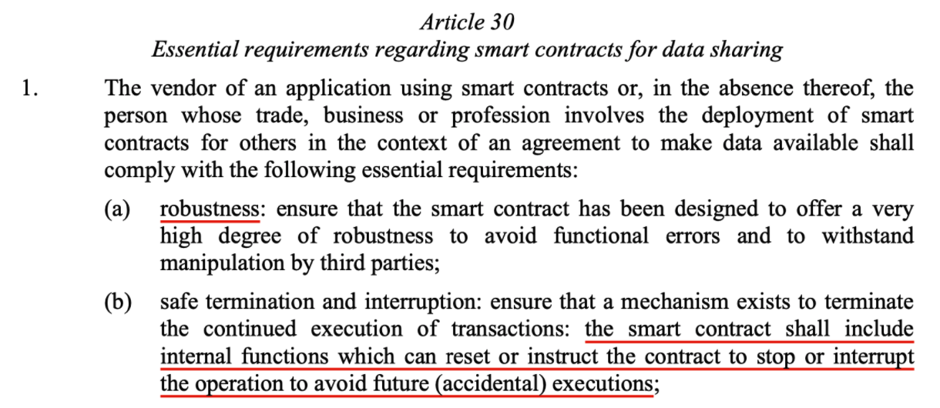
Data laws
Consider the EU’s proposed Data Act
https://digital-strategy.ec.europa.eu/en/library/data-act-proposal-regulation-harmonised-rules-fair-access-and-use-data

Slide 18
2 – Mining Pools
Equity: Are mining pools fiduciaries to their users? Can they act in their own best interests or in the interests of their users as a whole?
Tort: Do mining pools owe any duty of care to the blockchain or their users and if so to whom?
Competition & Consumer Act: is centralisation of mining power anti-competitive? If so, what is the relevant market? Is it cartel behaviour for mining pools to co-ordinate?
International Trade Law: Are you allowed to use a blockchain controlled by pools in a sanctioned country? Can you pay them fees?
Consumer Law: do mining pools provide a service or good and are they required to give statutory warranties?
Contract Law: is there a contract between mining pools and users?
Cyber Security: Is a 51% attack by one or more mining pools illegal computer hacking?
To get a better chance of mining blocks, miners are now organised into pools.
These are businesses that co-ordinate mining for many different users under the one banner and share mining rewards across all users.
Three pools in China control a majority of the hash rate on Bitcoin and Ethereum. Chinese validators tend to control a majority of voting power in Proof of Stake chains such as EOS.

Slide 19
3 – Mining Manufactures
Equity: Are manufacturers with commit access fiduciaries? Must they in the interests of users as a whole?
Tort: Do manufacturers owe a duty of care to anybody?
Competition Law: Are manufacturers dominant in a market? Do they operate as cartels? Should they be allowed to run pools and run their own mining operations?
Consumer Law: are they required to give statutory warranties?
Contract Law: is there a contract between manufacturers and miners? What could/should it say?
Privacy: Are manufacturers data processors with any special privacy obligations in how they design their machines?
Mining manufacturers produce the specialised ASIC machines that mine cryptocurrencies.
They have become ever more powerful. Unless you have access to the most recent, powerful machines your mining operations will likely be unprofitable and unsustainable.
Most mining manufacturers also operate mining pools.
There are allegations/suspicions that mining manufacturers use their own best machines first before releasing them to the broader market.

Slide 20
4 – Coders
Equity: Are coders with commit access fiduciaries and if so to whom? Must they in the interests of users as a whole?
Tort: Do coders owe a duty of care to anybody?
Consumer Law: do miners provide a service or good and are they required to give statutory warranties;
Back doors: must coders provide back doors for law enforcement under the Telecommunications and Other Legislation Amendment (Assistance and Access) Act 2018
Contract Law: is there a contract between coders and users or miners? Can there be a contract between coders and users or miners?
Privacy: Are coders data controllers under privacy laws? Do they have obligations regarding the design of the code, what it does and how it is used?
Cyber Security: If a coders makes use of a bug in the blockchain software, is that an illegal form of computer hacking?
IP: who owns the IP in the source code? Can coders claim moral rights over their code base in a blockchain project?
Blockchain projects tend to be open source and undertaken voluntarily by individual coders.
Anyone can work on the code because it is open source. Anyone can take the code and fork it.
Some programmer have code commit privileges – they have special access to the code repository allowing them to add variations to the code base.

Slide 21
4 – Exchanges
Equity: Are Exchanges fiduciaries in terms of using the power attached to the tokens users leave on their exchange?
Equity: Are they fiduciaries in terms of denying or freezing txns from hacked or scam accounts?
Tort: Do exchanges owe a duty of care to anybody?
Consumer Law: do exchanges provide a service or good and are they required to give statutory warranties?;
Back doors: must exchanges provide back doors for law enforcement under the Telecommunications and Other Legislation Amendment (Assistance and Access) Act 2018
Contract Law: do or can exchanges enter into contracts with users? With chains they list? Can those contracts negate other legal obligations?
Jurisdiction: which law applies to an exchange?
Tort: Consider the tort of unlawful interference in contractual relations: does it apply to blockchains where exchanges freeze someone’s tokens?
Exchanges are businesses that provide markets for people to exchange tokens for tokens or fiat currencies for tokens.
Most litigation in this space involves exchanges because they are “a throat you can choke” in an otherwise decentralised system.
We will look more deeply at the problem for exchanges as users of digital assets later.
The main issue here is the obligations exchanges have to the blockchains they list.

Slide 22
4 – Users
Co-venturers?: Are users co-venturers in a blockchain? Is there any relationship between them at all?
Use: Are Users liable to other users or miners for the use they make of a blockchain?
Tort: Consider the tort of unlawful interference in contractual relations: does it apply to blockchains?
Privacy: Are users bound by any privacy laws in relation to the use they make of private information discovered in using a blockchain?
Tort: Do users owe a duty of care to anybody?
Contract Law: is there a contract of any kind between two users?
Compellability: Can courts compel users to us a blockchain in a particular way to achieve particular outcomes?
Jurisdiction: which law applies to a transaction between two users?
Users are the people who use a blockchain for whatever purpose the blockchain suits their needs.
Most public blockchains are also permissionless – anybody can access them. There is no EULA.
In membership organisations the constitution is binding as a contract between members and the organisation and between each member and each other member.

Slide 23
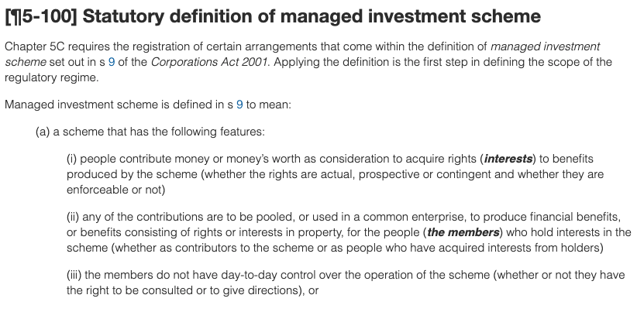
Managed Investment Scheme
Almost any coordinated activity is a scheme
“Contribution” means something more than “pay”
An enterprise can be common between two people who have only a third person in common
Day-to-day control means actual control by members as a whole, not just never-exercised legal control or control through a management committee

Slide 24
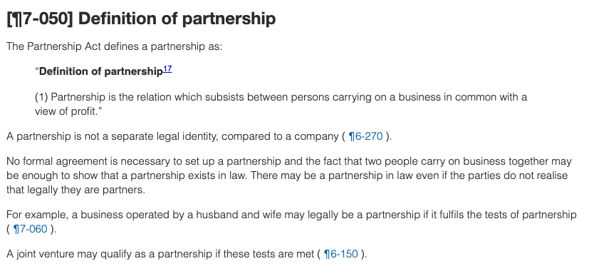
Partnership
Is there an agreement? Broader than contract, just a relation or agreement implied by circumstances
Is there a business? Broadly defined, ongoing and involve continuity and system
Is it carried on in common? Being agent or common interest in property is insufficient. Must be a mutuality of rights and obligations
Is there a view to profit? Means increase in value of balance sheet

Slide 25
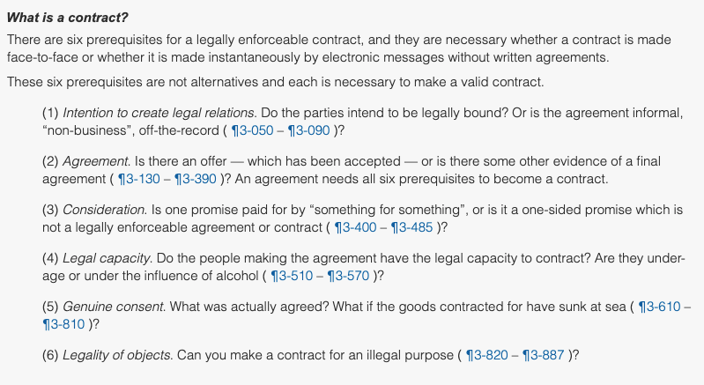
Contract
The major issue for blockchains:
Intention to create legal relations: Parties may have an agreement, but did they intend to have a contract?
Consideration: is there “something for something” in a system that is supposed to operate without middlemen?
Legal capacity: can there be a contract when you don’t know with whom you are contracting?
Genuine consent: how do you establish what was agreed between anonymous participants?

Slide 26
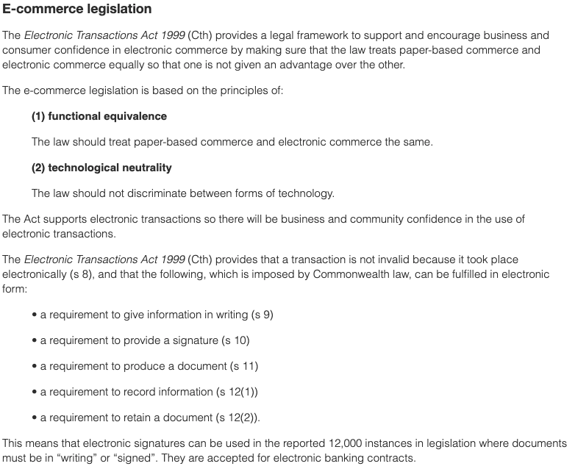
E-Comm
Australia has solid, nationally consistent legislation recognizing electronic transactions…

Slide 27
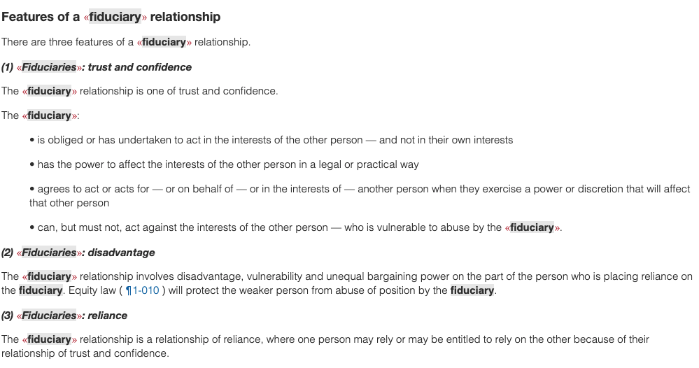
Fiduciary Obligations
In blockchains:
Miners?
Software Devs?
Exchanges?
What is the point of being a fiduciary under Australian law, if not a fiduciary under US or Canadian or English law…?

Slide 28
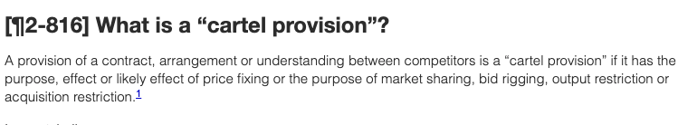
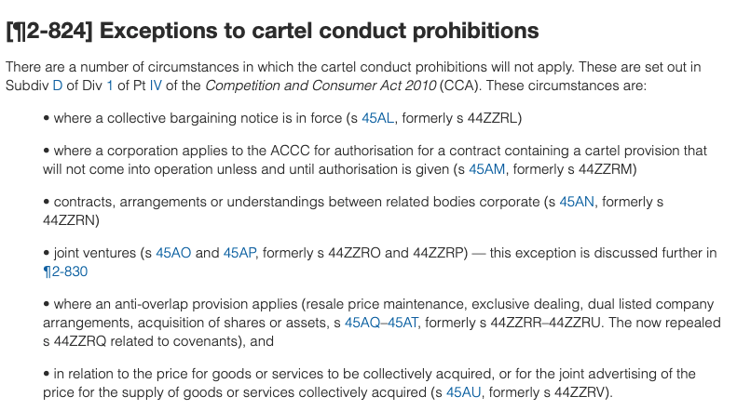
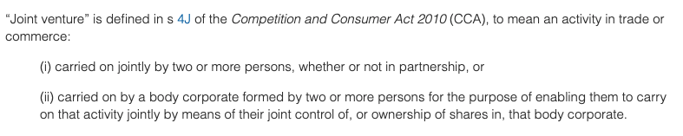
Cartel or JV?
There is an interplay between the cartel provisions of the CCA and the definition of a JV
JV can be a partnership
Is the blockchain and/or a smart contract and/or a DAO cartel behaviour?
Is it exempt as a joint venture or partnership?

Slide 29
Key Themes
Peer-to-Peer vs Hub & Spoke
Genuine lack of trusted third party?

Slide 30
Key Themes
Permissioned vs Permission-less
People doing stuff vs Groups doing stuff?
Emergent organisation vs Enforced organisation?

Slide 31
Key Themes
Is the Blockchain a Thing, An Entity, or a Relationship?

Slide 32
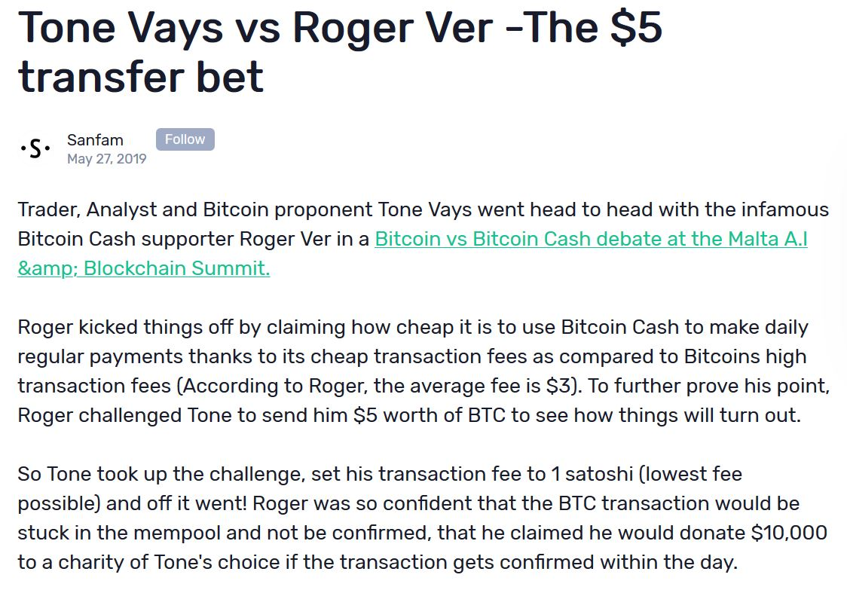
Tone Vays

Slide 33
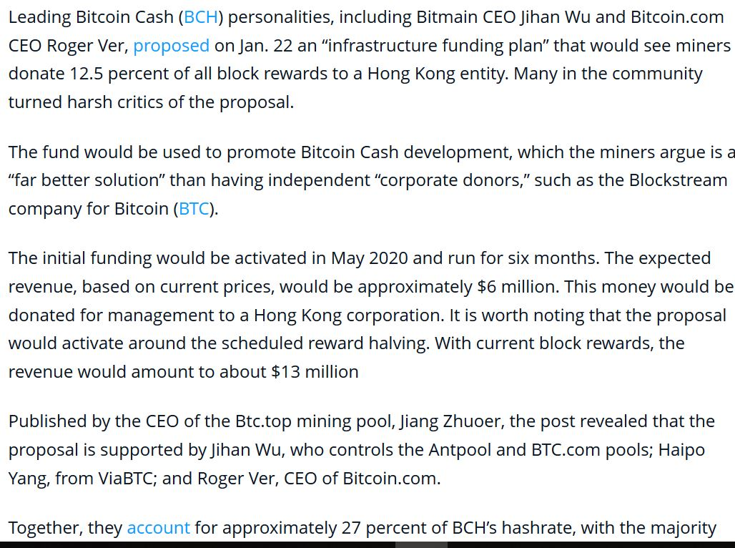
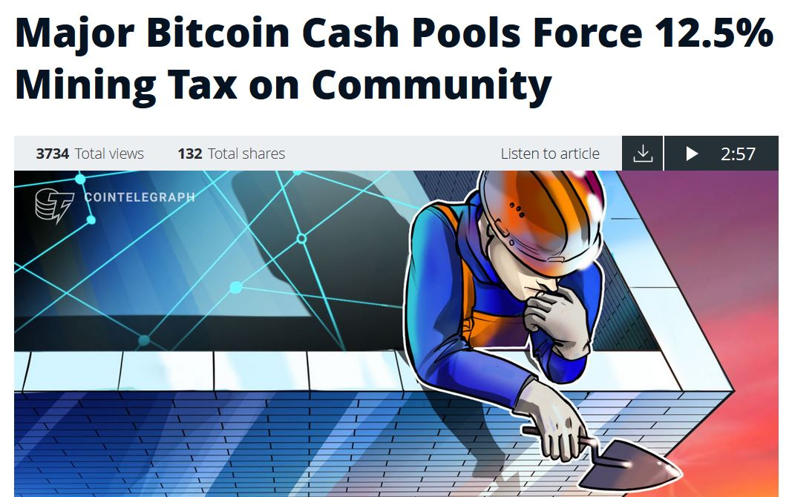
BCH Mining Tax

Slide 34
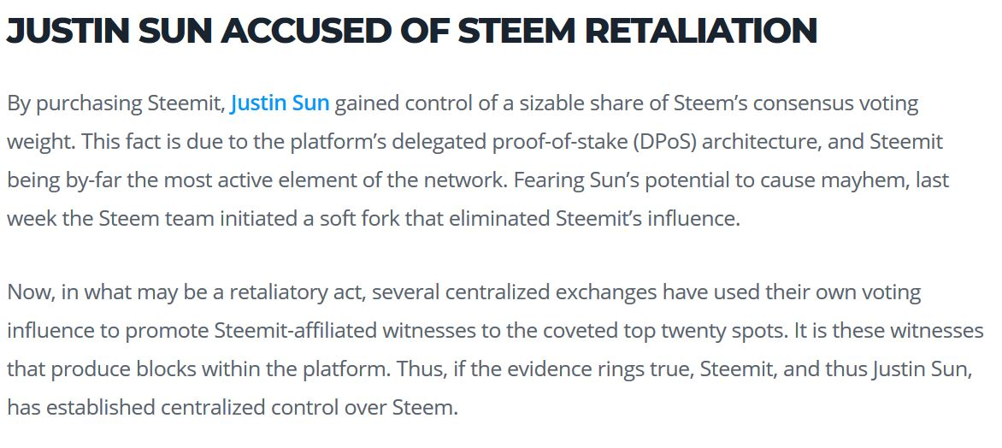
Steemit

Slide 35
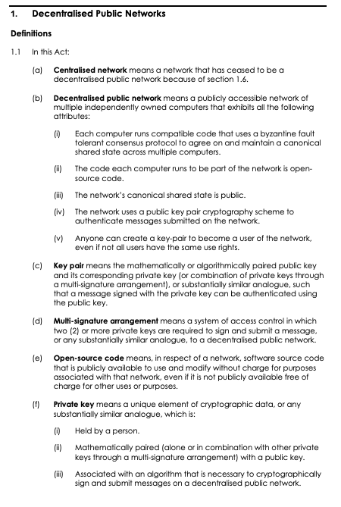
The Great Australian DAO Solution /1
Definitions are the key…

Slide 36
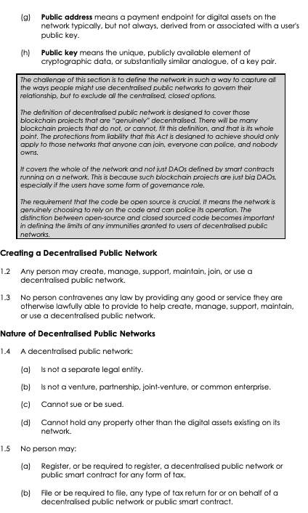
The Great Australian DAO Solution /2
Needed to exist without registration
Existence needed to be objective
Needed to confirm it was a relationship, not an entity

Slide 37
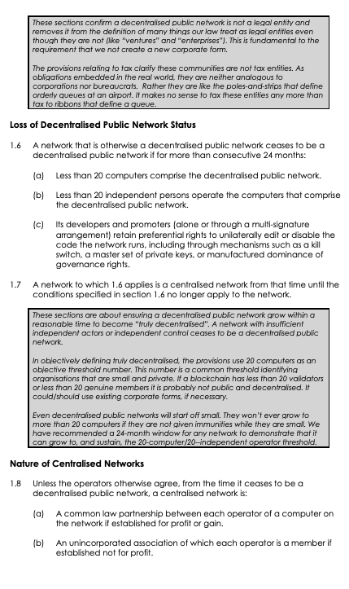
The Great Australian DAO Solution /3
Things not decentralised enough lost their DPN status
Non-DPNs are partnerships or unincorporated associations

Slide 38
QUESTIONS?

